Slide 1

Analysis 1: Foundations of Modeling Lesson 5.2: Sets in Python and cyclic algorithms (cont.)
Analysis Team, 2020/2021

Slide 2
Overview of this lesson: Sets in Python and cyclic algorithms
Sets in Python,
Creating sets, modifying sets, cardinality, membership,
Set operations, subset, superset, disjoint set,
Iterating through elements,
FOR loop,
Range() function,
Tuples and strings,
Indexes.

Slide 3
Overview of this lesson: Sets in Python and cyclic algorithms
Learning objectives:
Learn how to use sets in Python.
Learn about string and tuple types as immutable sequences.
Learn about for loop, ranges, iterations, indexes.
At the end of the lesson a student should be able to:
Use sets and set operations in Python.
Use for loops and indexes to access elements of immutable sequences.
Solve programming problems that require the use of sets / strings / tuples with cycles and indexing.

Slide 4
Sets in Python
Creating and modifying a set

Slide 5
Sets - recap
In the previous lesson we talked about sets.
What are sets?
A set is unordered collection of items.
Every element of a set is unique (there can be no duplicates).
In Python elements of a set are immutable (cannot be changed),
while the set itself is mutable (we can add or remove elements).

Slide 6
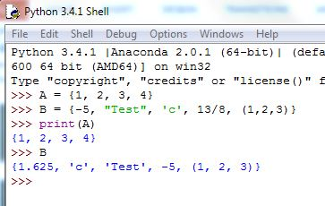
Creating a set
The quickest way to define a set is with curly braces { }, and type set members inside, separated with comma (,) sign.
Try:
A = {1, 2, 3, 4} PRESS ENTER
Members of a set don’t have to be of the same type.
Try:
B = {-5, “Test”, ‘c’, 13/8, (1,2,3)}
You can print set like any other variable (just type it in console, or use print() command)

Slide 7
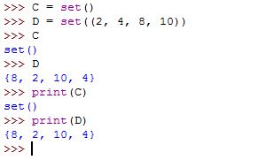
Creating a set
Alternatively, you can use set() command.
Typing C = set() will create an empty set.
If you want to create a set with set command you have to use double brackets (* we will see later why is that).
Try:
D = set((2, 4, 8, 10))
Print out sets C and D and let’s discuss results.

Slide 8
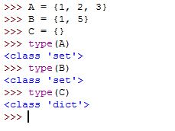
Creating a set
Important!
You must use set() to create an empty set!
Using { } with no elements inside will create a Python dictionary (a type we didn’t discuss yet).

Slide 9
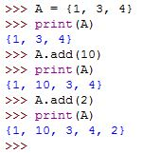
Adding member to the set
To add a member to the set we use the following syntax:
set_variable.add(new_member)
Use Python to create set A with members ‘1’, ‘3’ and ‘4’.
Print it to the standard output.
Then, use .add() to add ‘10’ to A.
Add ‘2’ in the same way.
Print out set A.

Slide 10
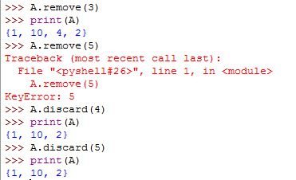
Removing member from the set
To remove an element we can use two commands:
remove()
discard()
The syntax in Python is the following:
set_variable.remove(set_member)
set_variable.discard(set_member)
Remove() will remove the element if it exists in the set. But, if it doesn’t, it will raise an error.
Discard() will remove the element if it exists in the set, but if it doesn’t it won’t do anything (and will not report an error).

Slide 11
Cardinality and membership

Slide 12
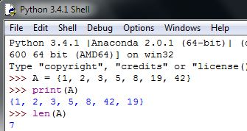
Cardinality
Using len() command, we can get the cardinality of the set (how many members it contains).
Try creating an arbitrary set A.
Use len() command to get the cardinality of A.
Try:
len(A)
You can also assign that value to a variable, e.g.
n = len(A)

Slide 13
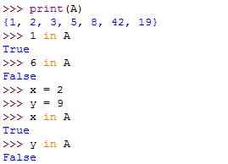
Testing membership
To test if an element belongs to the set we use in operator (e.g. a ∈ A).
in operator returns boolean value. True if a member exists and False if it doesn’t.
Try creating an arbitrary set A.
Use in to test membership for an element that exists and an element that doesn’t.
Note: you can also test variable. In that case, in will check if the value of the variable is a member of the set.

Slide 14
Python set operations

Slide 15
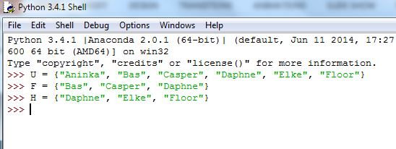
Set operations – setting up
To show set operations in Python we will use the same example covered in the theoretical lesson.
Let U be a set of teachers:
U = {"Aninka", "Bas", "Casper", "Daphne", "Elke", "Floor"}
Let F be a set of teachers playing football:
F = {"Bas", "Casper", "Daphne"}
Let H be a set of teachers doing equestrian sports:
H = {"Daphne", "Elke", "Floor"}

Slide 16
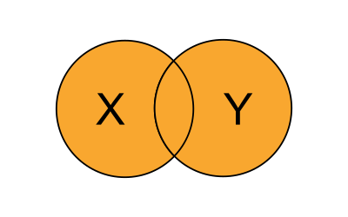

Union
Union of two sets is a set with all elements from both sets.
In Python we use .union() method.
set1.union(set2)
Try using union to get all teachers playing football or doing horse-riding.
Type:
F.union(H) or
H.union(F)

Slide 17
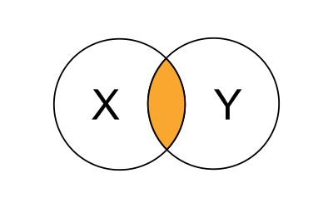

Intersection
Intersection of two sets is a set of elements common to both sets.
In Python we use .intersection() method.
set1.intersection(set2)
Try using intersection to get all teachers playing both football and doing horse-riding.
Type:
F.intersection(H) or
H.intersection(F)

Slide 18
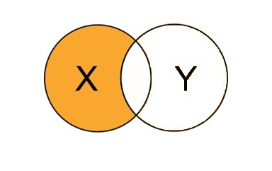

Difference
Difference of two sets is a set of elements that only exist in one set but not the other.
In Python we use .difference() method.
set1.difference(set2)
Try using difference to get all teachers playing only football.
Type:
F.difference(H)
Alternatively, you can use - operator:
F - H

Slide 19
Subset, superset and disjoint set

Slide 20
Sets, more methods
We will use the following methods in Python:
.isdisjoint() → determines if two sets are disjoint (have any common elements)
.issubset() → determines if one set is a subset of another
.issuperset() → determines if one set is a superset of another

Slide 21

Disjoint set
Let’s test if our sets F and H are disjoint.
Try:
F.isdisjoint(H)
It returns False because F and H have one common element “Daphne”
Without “Daphne” F and H have no common elements, so let’s test the method again.
Try:
F.isdisjoint(H.difference({“Daphne”}))

Slide 22
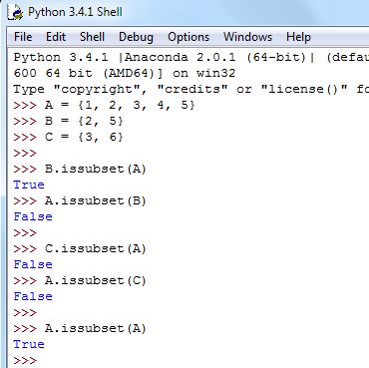
Subset
A set is a subset of another set, if all of its elements are also elements of that other set.
Create the following sets:
A = {1, 2, 3, 4, 5}
B = {2, 5}
C = {3, 6}
Use .issubset() to test if B or C are subsets of A.
Remember: a set is always a subset of itself.

Slide 23
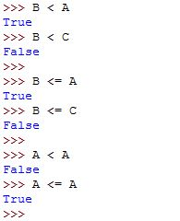
Subset
Alternatively, we can use <= operator to test if the set on the left is a subset of the set on the right.
Try:
B <= A
C <= A
A <= A
Operator < allows us to test if a set is a proper subset of another.
Try:
B < A
C < A
A < A

Slide 24
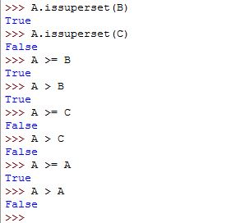
Superset
In the similar manner we can use .issuperset() method or >= operator to test if one set is a superset of another.
To test if a set is a proper superset, we can use > operator.
Try:
A.issuperset(B)
A >= B
A > B
A >= A
A > A

Slide 25
List of Python set commands and methods
command / method | description
add() | Adds and element to the set.
clear() | Removes all elements from the set.
copy() | Returns a copy of the set.
discard() | Removes an element from the set. If an element doesn’t exist, it won’t do anything.
remove() | Removes an element from the set. If an element doesn’t exist, it will raise an error.
update() | Updates the set with the union of itself and others.

Slide 26
List of Python set commands and methods
command / method | description
difference() | Returns the difference of two or more sets as a new set.
intersection() | Returns the intersection of two sets as a new set.
isdisjoint() | Test intersection and returns True if both sets have no common elements.
issubset() | Returns True if another set contains this set.
issuperset() | Returns True if this set is contained in another set.
union() | Returns the union of sets in a new set.

Slide 27
List of Python set commands and methods
command / method | description
len() | Returns the cardinality – the number of items in the set.
max() | Returns the largest item in the set.
min() | Returns the smallest item in the set.
sorted() | Returns a new sorted list from elements in the set.
sum() | Returns the sum of all elements in the set.

Slide 28
Iterating through elements
FOR Loop

Slide 29
For loop
In the previous practical lesson we introduced WHILE loop.
With WHILE loop we create cycles in algorithm that repeat while the condition is true.
FOR loop also creates cyclic structure, but unlike WHILE loop, repeats one block of steps fixed number of times.
FOR loop is typically used to iterate over a sequence.

Slide 30
For loop – Python syntax
This is an iterator that will be assigned one
element from the sequence with each iteration.
iterator is followed by keyword ‘in’
Let’s take a closer look:
for iterator in sequence:
statement(s)
for statement must be closed with ‘:’
some sequence we want to iterate over
One or more program statements.
It is these statements that will be executed
for every element in the sequence.
This is the keyword that tells Python we are using for loop.

Slide 31
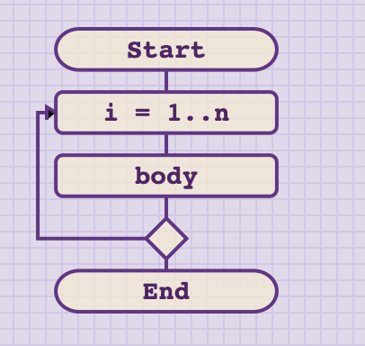
For loop - flowchart
for loop
setting iterator
body
end of one iteration

Slide 32
Iterating through the set
A = { 1, 2 , 3, 5, 8}
for element in A:
print(element)
element
element
5
2
1
8
3
standard output

Slide 33


Iterating through the set
We can use for loop to iterate through all elements of a set and print them out.
Note that with each iteration element will be assigned one member from the set!
We can show it by printing out the iterator element.
Note that the order in the set doesn’t matter, so in this case we got element 8 first.

Slide 34
Range function
range() is a powerful Python function.
range() is used to generate a sequence of numbers over time.

Slide 35
Range syntax
start is the value the sequence should begin with.
It is optional and can be omitted.
If omitted, it defaults to 0.
Let’s take a closer look:
range( start, stop ,step)
Step is the step size of the sequence.
It is optional and can be omitted.
If omitted, it defaults to 1.
stop is the endpoint of the sequence.
stop is REQUIRED.
The last value (stop) will NOT be included in the sequence!!!
This is the keyword that tells Python to generate a sequence.

Slide 36
Range function
What sequence do we generate with the following:
range(1,10)
range(5)
range(0,10)
range(0,10,2)
range(2,10,3)
range(10,1)
range(10,1,-1)
range(20,-5,-3)

Slide 37
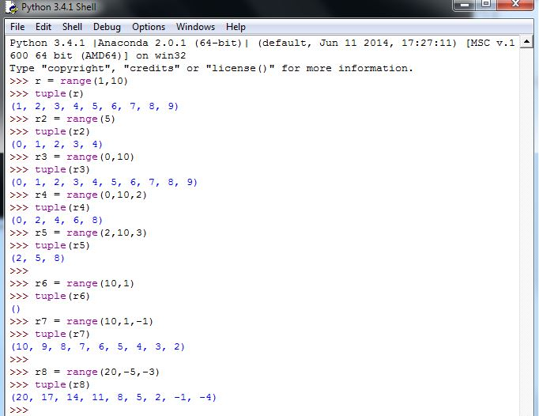

Slide 38


Iterating over range
Combining for loop and range() allows us to easily execute one block of statements exactly n times.
As can be seen from the execution, for n = 5, the print statement was executed 5 times.
Note: some programming languages typically count from 1 and some from 0. Python by default counts from 0.

Slide 39
While VS For loop
While and For loops are both part of the cyclic structure.
Statements in the body of while are executed as long as the given condition is evaluated as true.
Statements in the body of for are executed fixed amount of times, corresponding exactly to the length of the sequence given.
Therefore, every for loop can be written as while loop.
But … not all while loops can be written as for loops.
In the previous lesson we used while to create counters. Counters are typically easier to implement using for loop.

Slide 40
Exercise 1 – practice with range
PROBLEM STATEMENT: Ask user to input two numerical values M and N. Then print all values in interval [M, N].
Implement the solution using:
a) while loop
b) for loop
Time: 5 – 10 min.

Slide 41
Exercise 2 – multiplication table
PROBLEM STATEMENT: You want to help your young cousin learn multiplication table, and you set out to design an algorithm that will for given number X (1 <= X <= 10), calculate and print the result of X multiplied by numbers in range [1, 10].
Example (for X = 5):
5 * 1 = 5
5 * 2 = 10
5 * 3 = 15
…
5 * 10 = 50
Design an algorithm, make a flowchart and implement it in Python.
Time: 5 – 10 min.

Slide 42
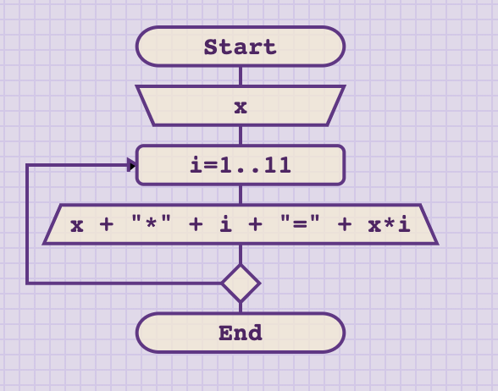

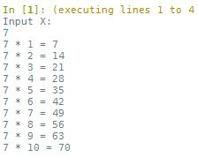
Exercise 2 – multiplication table
solution

Slide 43
Problem 3 – multiplication table for all numbers 1-10
PROBLEM STATEMENT: Extend the previous solution that it prints multiplication tables for all numbers from 1 to 10.
Also, prevent repetition (e.g. if 2 * 6 = 12 is printed, do not print 6 * 2 = 12)

Slide 44
Problem 3 – multiplication table for all numbers 1-10
DISCUSSION:
The first modification is an obvious one. Instead of reading X from the standard input, we can add one additional for loop to iterate through all numbers from 1 to 10.
To avoid repetition, we want the inner for loop to start from the range greater than the iterator in the outer loop!

Slide 45
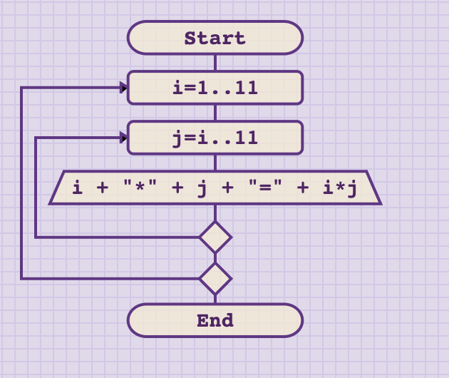

Problem 3 – multiplication table
flowchart and code
This is a nice example of nested for loops.
Note how we use the iterator from the
outer loop as the starting point in inner loop.

Slide 46
Problem 3 – multiplication table for all numbers 1-10
Question: How many times will the output step be executed?
i = 1 → j = range(1,11) → 10 times
i = 2 → j = range(2,11) → 9 times
i = 3 → j = range(3,11) → 8 times
i = 4 → j = range(4,11) → 7 times
i = 5 → j = range(5,11) → 6 times
i = 6 → j = range(6,11) → 5 times
i = 7 → j = range(7,11) → 4 times
i = 8 → j = range(8,11) → 3 times
i = 9 → j = range(9,11) → 2 times
i = 10 → j = range(10,11) → 1 time
55 times!

Slide 47
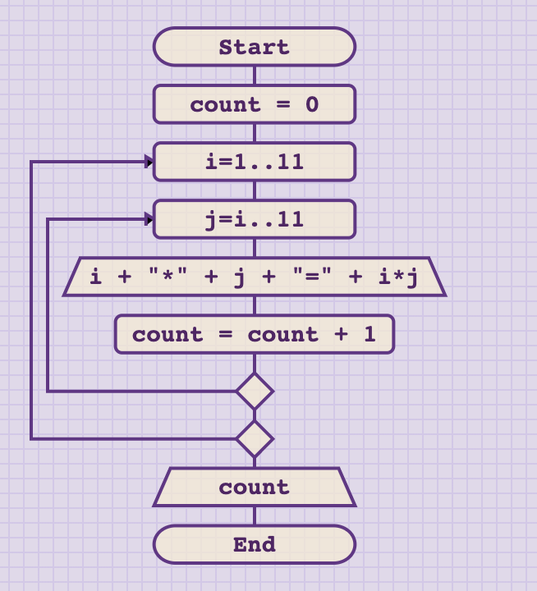
Problem 3b – counting outputs
If you don’t believe me, add counter and let Python do the counting!

Slide 48
Tuples and strings

Slide 49
Tuples and strings
We have encountered strings in lesson 2.2. With what we learned today we can interpret strings as …
string = an ordered, immutable sequence of characters.
* remember: sets are unordered and mutable.
In Python there is another similar data type that is often used:
Tuple = an ordered, immutable sequence of objects.
Objects can be almost anything, including other tuples.

Slide 50
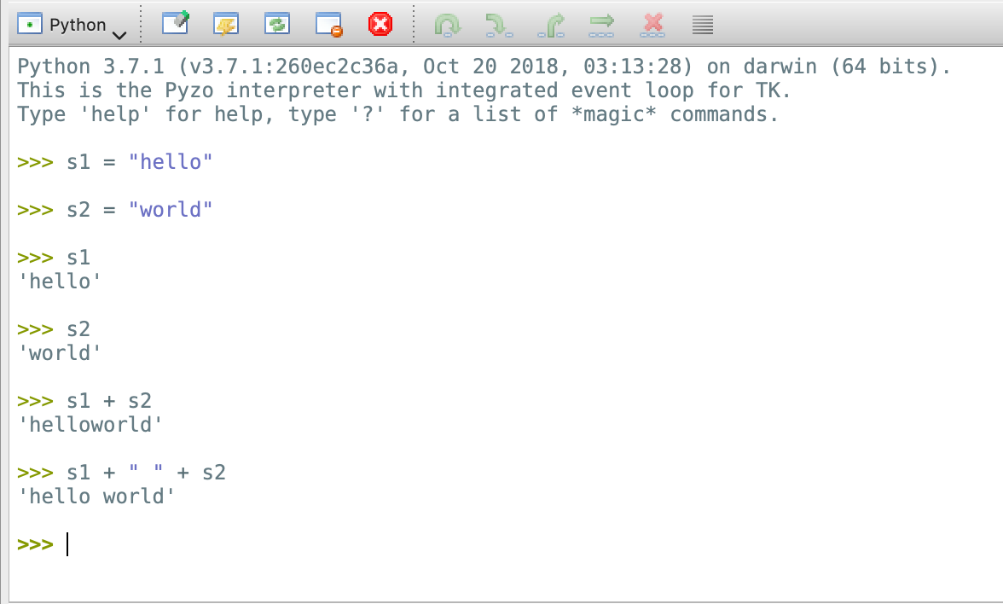
Strings
In Python, any characters written between the quotes (either single ‘ or double ") will be treated as strings.
You should also recall that input() function in Python always returns string.
Here, we will assign two string values to variables s1 and s2, such that s1 = "hello" and s2 = "world"
To output the values, it works the same like any other variable. Either type its name in the console, or use print command.

Slide 51
Strings, concatenation
In Python, operators + and * are overloaded operators. That means that they have different implementations depending on the type of arguments used.
Using + with strings results in string concatenation, e.g. this operator joins two strings together.
For s1 and s2, try:
s1 + s2
s1 + " " + s2

Slide 52
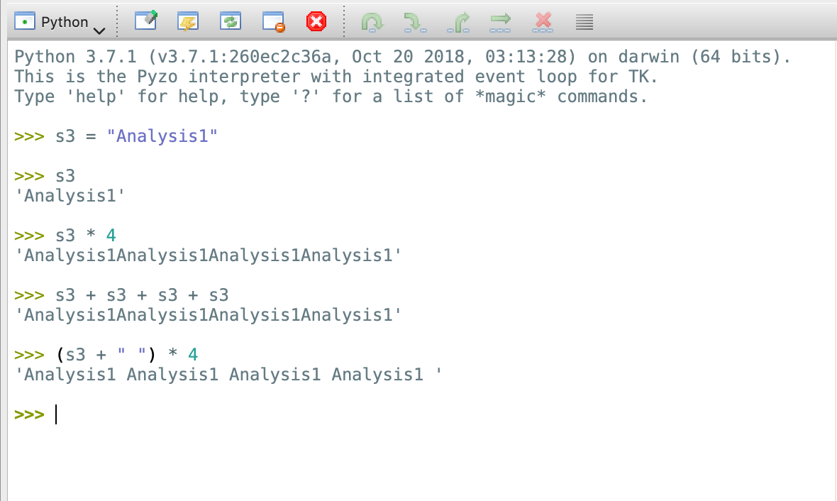
Strings, repetition
Operator * can be used to repeat a string. It requires two values, a string and an integer.
Try:
s3 = "Analysis1"
s3 * 4
Although, it may look puzzling at first, it actually makes sense as:
s3 * 4 is the same as:
s3 + s3 + s3 + s3
You can combine + and * if desired.

Slide 53
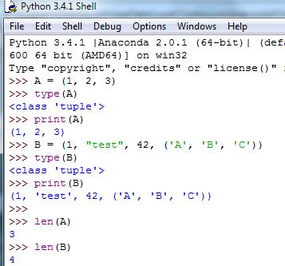
Tuples
Let’s create few tuples.
Try:
A = (1, 2, 3) PRESS ENTER
B = (1 , “test”, 42, (‘A’, ‘B’, ‘C’))
Use type() to check the type of variables A and B.
Print the values of A and B.
We can count the members in the same way we did with sets – using len() command.
Find out the number of elements in A and B.
Why do you get len(B) = 4?

Slide 54
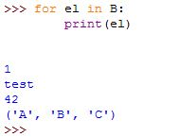
Iterating over tuples and strings
Now that we know that tuples and strings are SEQUENCES, and that with FOR loop we iterate through sequences, we can combine this knowledge and iterate over tuples and strings.
Let’s find out why len(B) returned 4. Let’s iterate over elements of tuple B.
The 4th object is actually a nested tuple and as such counts as 1.

Slide 55
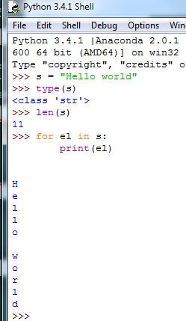
Iterating over tuples and strings
Let’s try to iterate over an arbitrary string s.
Try:
s = “Hello world” (or anything else)
Check the type and length of s.
type(s)
len(s)
Next, iterate over s and print each character one by one.
for el in s:
print(el)

Slide 56
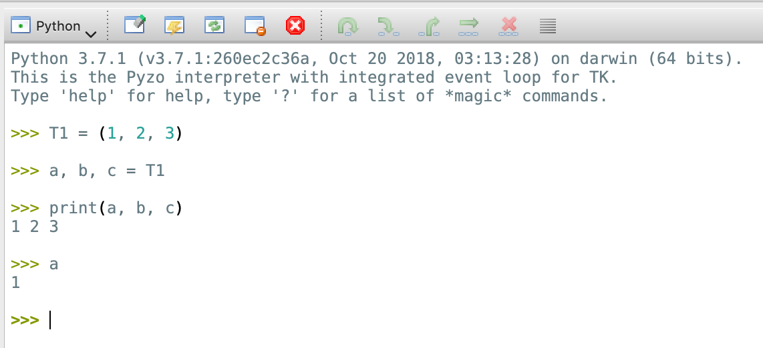
Unpacking tuples
To get specific values from tuple we can either unpack it, or use indexes.
Unpacking tuple means assigning a sequence of tuple values to multiple variables.
Try:
T1 = (1, 2, 3)
a, b, c = T1
Print out the values to confirm.
With a, b, c = T1, we unpacked tuple, thus assigning each of its values to one variable (a, b and c).

Slide 57
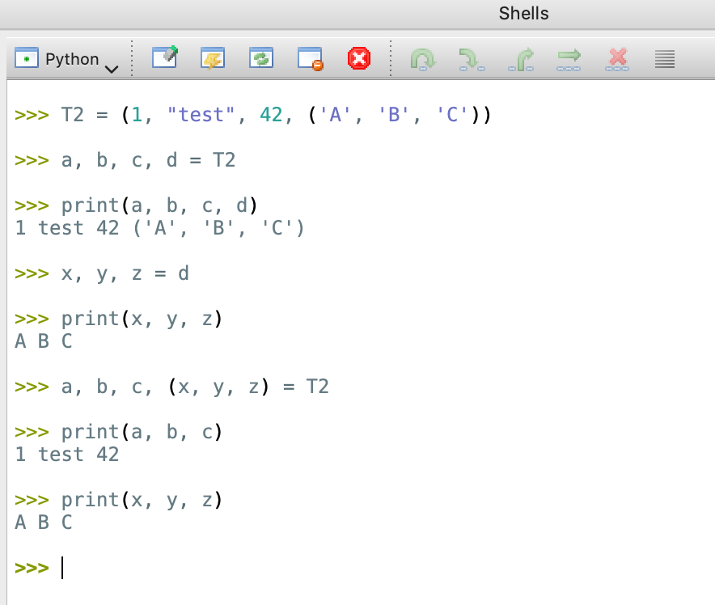
Unpacking nested tuples
The process is the same for nested tuples.
Try:
T2 = (1, "test", 42, ('A', 'B', 'C’))
a, b, c, d = T2
If you check the type, variable d is still a tuple (because it was nested), so you can unpack it further with:
x, y, z = d
Or, you can also use nesting:
a, b, c, (x, y, z) = T2

Slide 58
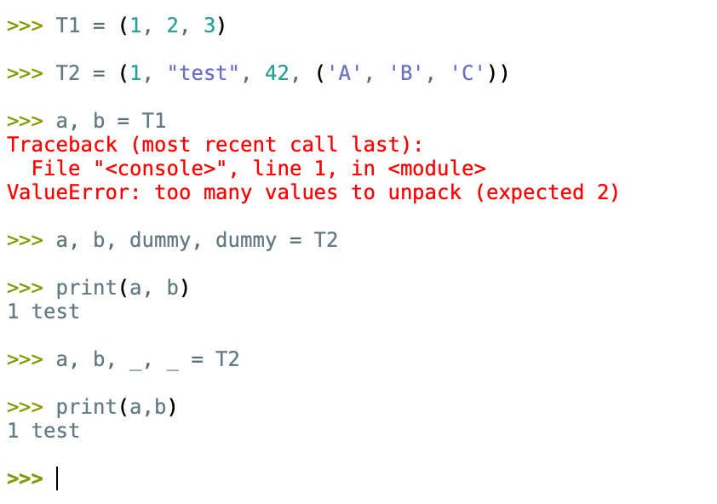
Unpacking tuples
Note that you must provide the same number of variables as the number of elements in the tuple.
Providing too few, or too many will raise an error.
Try:
a, b = T1
If you only need specific values, you can use “a dummy” variable for the ones you don’t need.
Try:
a, b, dummy, dummy = T2
To avoid confusion if someone else uses your code, Python programmers typically use _ to temporary hold the value that is not needed.

Slide 59
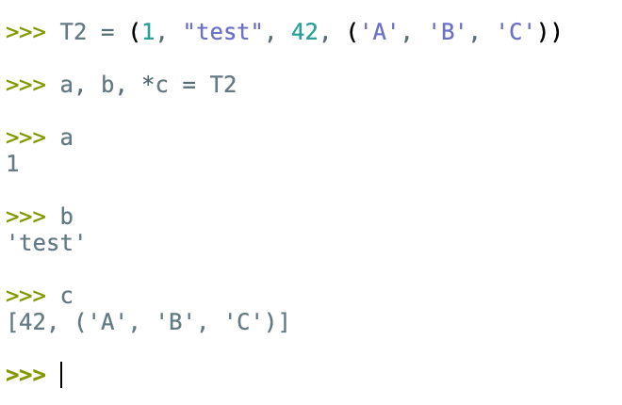
Unpacking tuples
The elements we don’t need can also be unpacked to a list (this type is not covered yet).
Here, we only show you the syntax should you encounter code like this in the future, but is not required knowledge at this point.

Slide 60
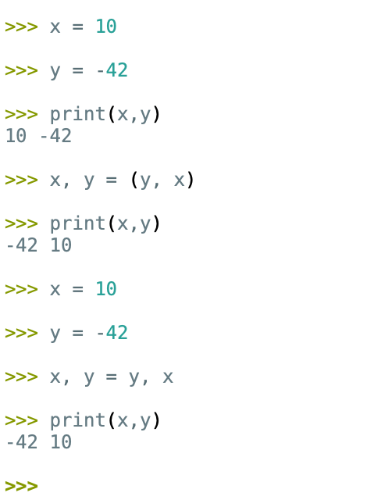
Unpacking tuples - exchange values
In week 2, one of the exercises asked you to exchange the values of two variables, and to do that, you had to use another, temporary variable, to store a value.
In Python, there is an efficient way to do the same process in one line, using tuples and tuple unpacking.
Assign some values to variables x and y.
Try:
x, y = (y, x)
Omitting parenthesis in this case is allowed, so the following statement is also correct:
x, y = y, x

Slide 61
Indexes

Slide 62
Index
In Python, index is meant as position.
Index refers to a position within an ordered sequence.
Therefore, we can access each element in a sequence directly by using its index.
Let s be a string “abc” and let t be a tuple (2, 5, 8).
Remember than Python counts from 0, so the first element is actually 0, the second element is 1 and so on …
We can get the first element of s by typing s[0], where 0 is the index value.
In the same manner we can get the second and the third element from t: t[1], t[2].

Slide 63
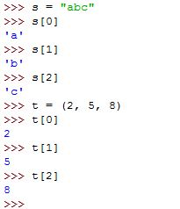
Index
Assign value “abc” to string s.
Assign value (2, 5, 8) to tuple t.
Use indexes to access each member of s and t.
Note: we can’t use indexes on sets because sets are unordered!

Slide 64
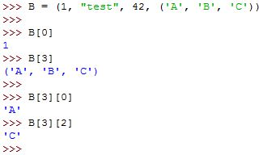
Index – nested members
Let’s revisit our nested tuple B.
B = (1, “test”, 42, (‘A’, ‘B’, ‘C’))
Access the first element using index.
B[0]
Access the fourth element using index.
B[3]
Since this element is actually nested tuple, we can use another index to get its members.
Try:
B[3][0]
B[3][2]

Slide 65

Iterating with indexes
Ordered sequences can be iterated using indexes.
We already know how to find the number of elements using len().
We know how to create a sequence of numbers 0 – N-1 using range().
And, we also know how to use for to iterate over such sequence.

Slide 66
Problem 4 – string slicing
PROBLEM STATEMENT:
Read string S from the standard input and two natural numbers M and N, such that 0 <= M < N < len(S).
Write an algorithm that will create substring of S starting from index M and ending at index N.
Important: strings are immutable, so you can’t change the content of the string, but if a variable is a string, you can assign a new value to it that is the result of current variable value concatenated with a new character (use operator +)

Slide 67
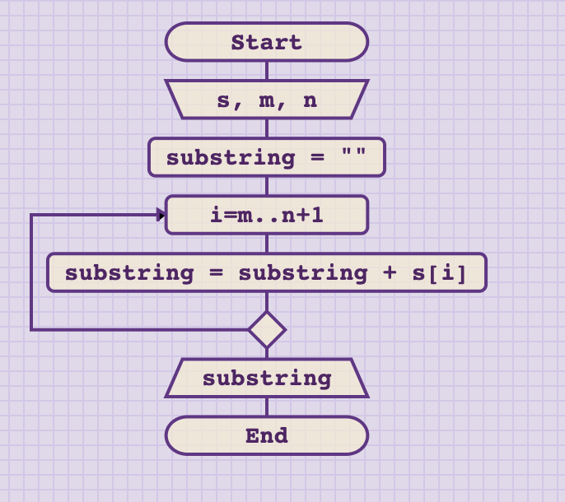
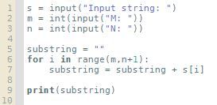
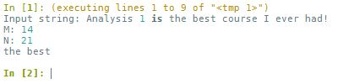
Problem 4 – string slicing
solution

Slide 68
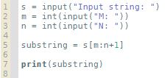
Problem 4 – string slicing
Note: problem 4 was solved in “language independent” way.
However, Python has very powerful mechanisms for string manipulation, allowing to use just one line instead of entire for loop.
Slice objects are indices specified by range(start, stop, step).
In our case, substring = s[m,n,1].
Since step = 1 by default, we can also write it as: substring = s[m,n]
Notes:
Note: show students slicing since they will most likely encounter such examples when browsing through online sources. For Analysis 1, Python slicing is not needed.

Slide 69
Problem 5 – censor
PROBLEM STATEMENT:
Ask the user to input any sentence and save it as string S. Your job is to censor this string by replacing each character with “X” if it is contained in the set of “forbidden” characters.
“Forbidden” characters are also entered by the user inside of a loop, one character at a time, stopping when no character is entered (user just pressed ENTER).
Display censored string.
Example: Input: “Hello world”; ‘e’, ‘o’, ‘k’
Output: “Hxllx wxrld”

Slide 70
Problem 5 – censor
DISCUSSION:
This is a “big” problem that we have to decompose into smaller parts.
Try to answer the following questions:
How can you collect (input) all characters that need to be censored?
We can use WHILE loop and iterate until empty character is given.
What is the most appropriate structure to save them?
Since we don’t want repetition, SETS can be effectively used here.
How can you check if some character from S needs to be replaced?
We can use FOR loop to iterate through all characters in S.
How can you perform the replacement?
We can create a new string and append to it one character at a time. If that character is to be censored, we append “X”, otherwise we append S[i].

Slide 71
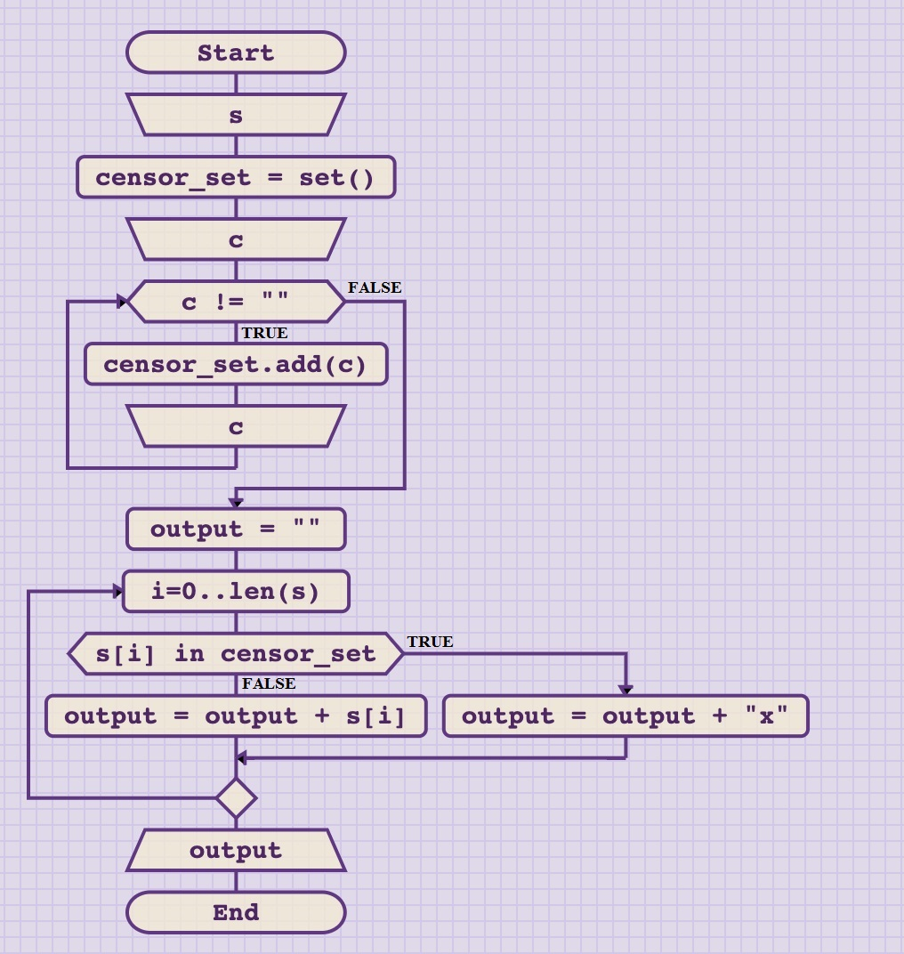
Problem 5 – censor (flowchart)

Slide 72
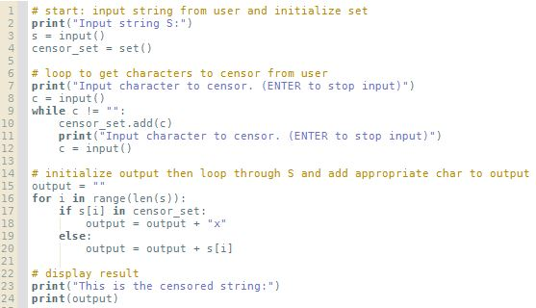
Problem 5 – censor (Python code)

Slide 73
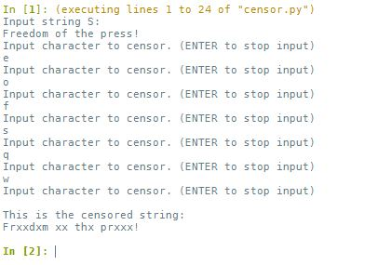
Problem 5 – censor (test)

Slide 74
Problem 6 – clean input (measuring learning objectives)
Exercise:
Ask the user to input a string containing alphanumerical characters (letters and numbers). Then, process the string to filter out anything except numbers, convert it to integer and print it out.

Slide 75
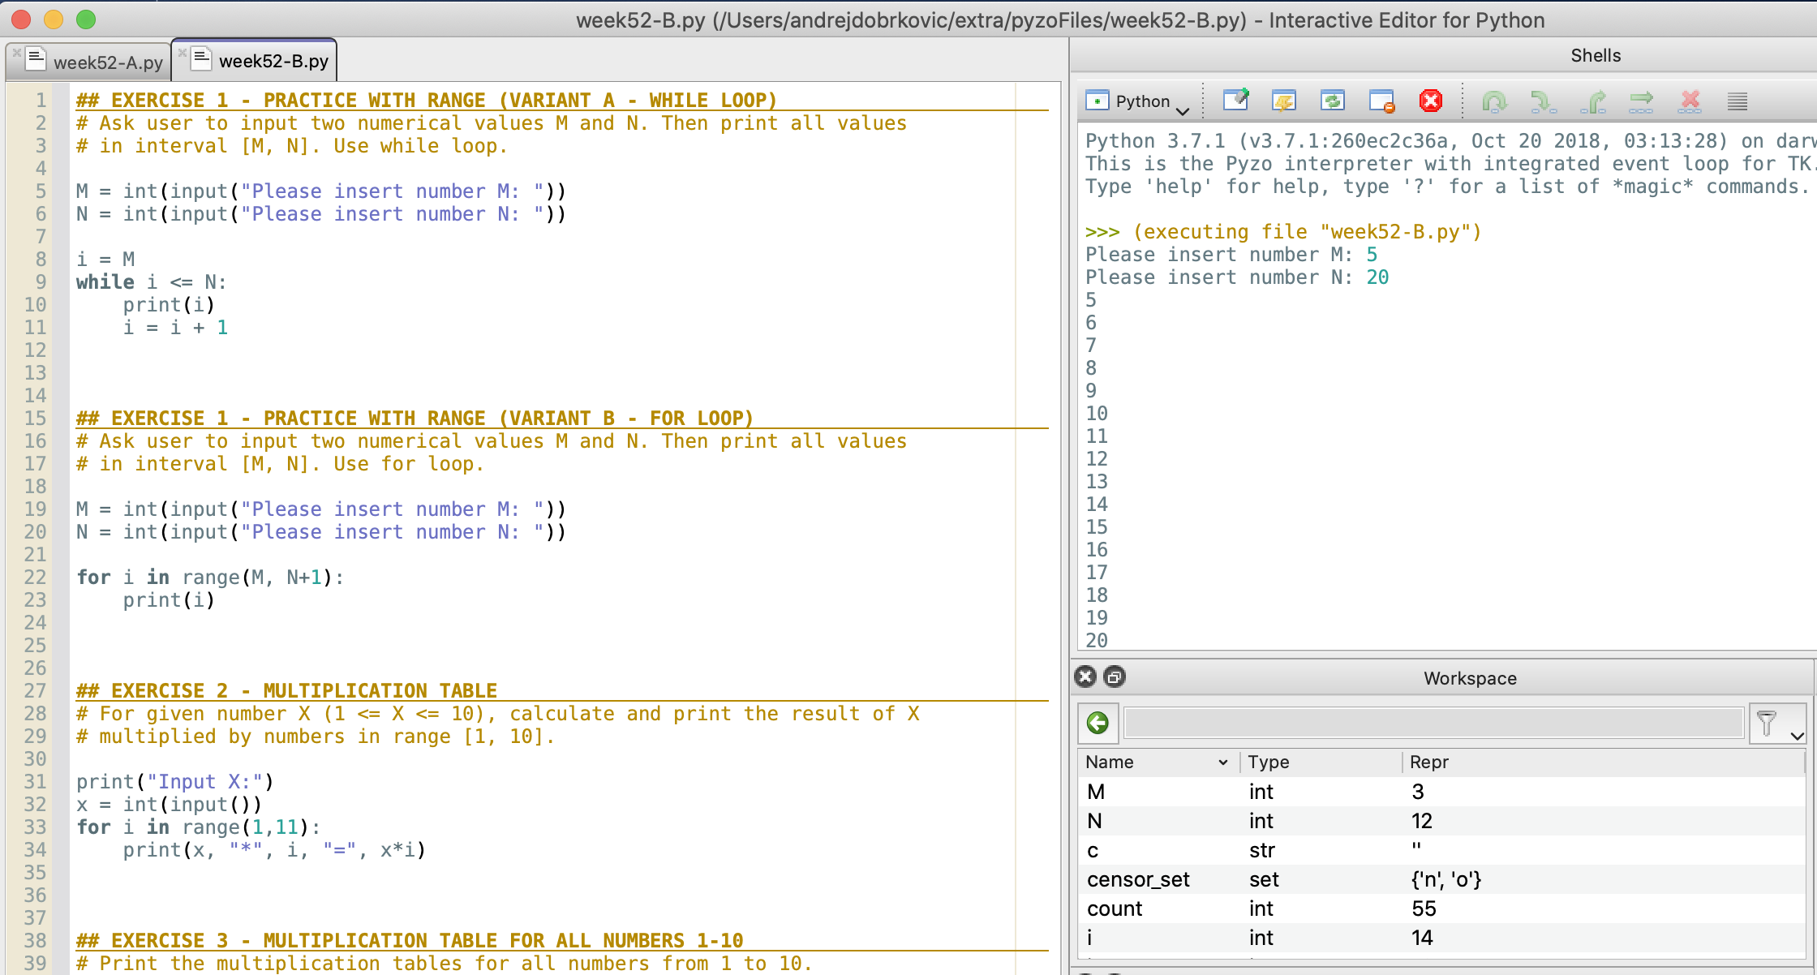
Code for the exercises 1-5
Python code for exercises 1-5 can be found in the file week52-B.py.
Either copy-paste each exercise into a new file and then run it.
Or comment out the parts you don’t need, and execute the entire file.
If you are using Pyzo, each exercise is given as a separate cell (starts with ##). You can run a single cell by clicking inside it and choosing Run → Execute cell from the menu.
Pyzo also allows you to highlight one section of the code and execute it line-by-line in the shell. For that option, highlight the code you want, then choose: Run → Execute selection.

Slide 76
Python built-in string methods
Method | Description
.capitalize() | Converts the first character to upper case.
.count() | Returns the number of times a specified value occurs in a string.
.find() | Searches the string for a specified value and returns the position of where it was found
.lower() | Converts a string into lower case.
.replace() | Returns a string where a specified value is replaced with a specified value
.split() | Splits the string at the specified separator, and returns a list.
.upper() | Converts a string into upper case.

Slide 77
Python built-in string methods
Method | Description
.isalnum() | Returns True if all characters in the string are alphanumeric.
.isdigit() | Returns True if all characters in the string are digits.
.islower() | Returns True if all characters in the string are lower case.
.isspace() | Returns True if all characters in the string are whitespaces.
.isupper() | Returns True if all characters in the string are upper case.
For the complete list visit: https://www.w3schools.com/python/python_ref_string.asp

Slide 78
Summary Quiz
How can you define sets in Python?
How can you add elements to the set?
Which two methods can you use to remove an element from the set? What is the difference?
What does len() command do? Where can we use it?
How can we test if the membership of an element in a set?
What is the purpose of FOR loop?
How many times are the steps in the body of FOR loop executed?
What as an iterator?
What does range() function do?
What are the parameters of range() function? Which are required and which can be omitted?

Slide 79
Summary Quiz
What is the difference between WHILE and FOR loop?
What is a string?
What is a tuple?
What is an index?

Slide 80
Summary
Sets can be defined using curly braces { }, and typing set members inside, separated with comma (,) sign. Alternatively, set() can be used to create an empty set.
To add element to the set, use it’s variable plus the method .add(), writing a new member inside parenthesis.
Elements from the set can be removed using remove() or discard() method. Both will remove an element if it exists in the set, but if not, remove() will raise an error, while discard() will just ignore it.
len() command will return the cardinality of a set, or the number of elements in tuple, number of characters in string, etc.
To test if an element belongs to the set we use in operator (e.g. a ∈ A).
FOR loop is used to iterate over a sequence.
FOR loop repeats one block of steps fixed number of times.
An iterator is a variable that will be assigned one element from the sequence with each iteration. Typically, the first iterator is named ‘i’, then ‘j’, ‘k’, …

Slide 81
Summary
range() function is used to generate a sequence of numbers over time.
The parameters of range function are start, stop and step. Only stop is required, while start and step can be omitted. If omitted, start = 0 and step = 1.
In WHILE loop statements in the body are executed as long as the given condition is evaluated as true. In FOR loop statements in the body are executed fixed amount of times, corresponding exactly to the length of the sequence given. Every for loop can be written as while loop, but not all while loops can be written as for loops.
String is an ordered, immutable sequence of characters.
Tuple is an ordered, immutable sequence of objects.
Index refers to a position within an ordered sequence. Using index, we can access each element in a sequence directly.

